Slide 1

Google Cloud Platform y Spring
JORGE LÓPEZ BLASCO

Slide 2

Índice
Introducción
Servicios GCP
Spring Cloud App Engine
Spring Boot GKE
Spring Boot Cloud SQL
Cloud Function
Spring Boot Cloud Storage
Place API Java Client

Slide 3


Slide 4
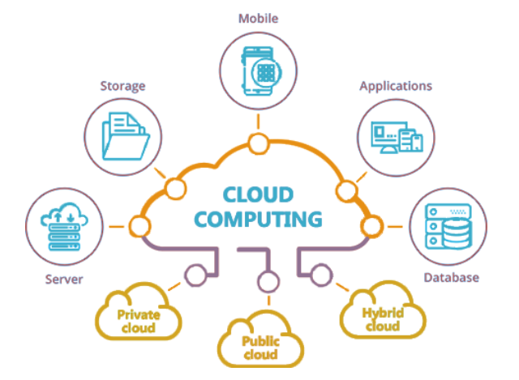

Slide 5
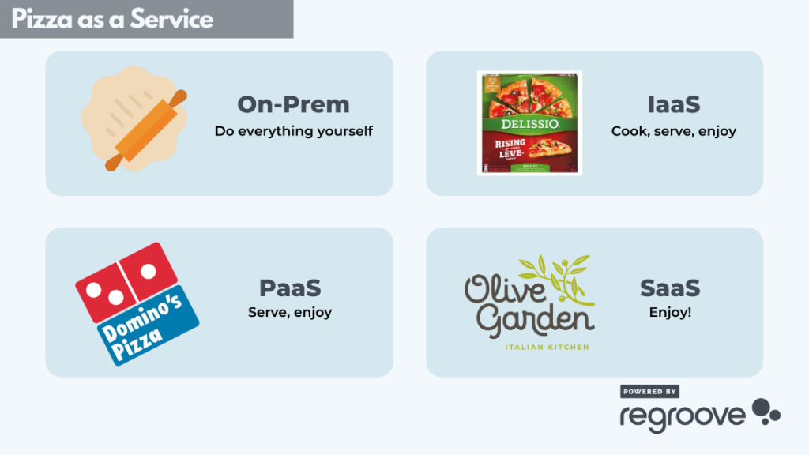

Slide 7
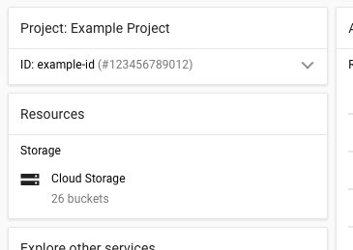

Slide 8
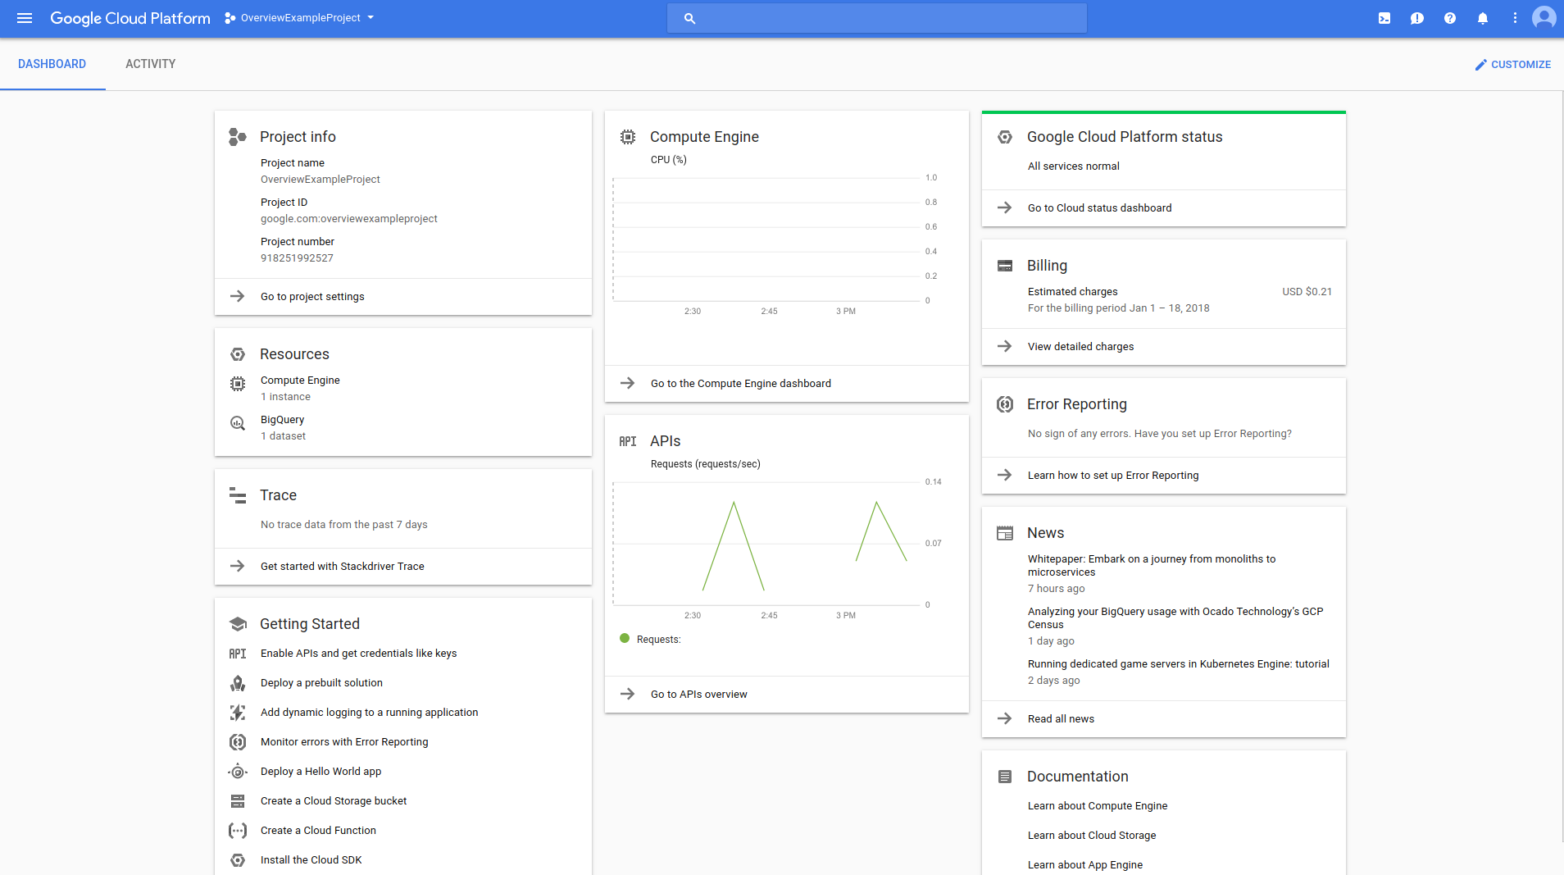

Slide 9
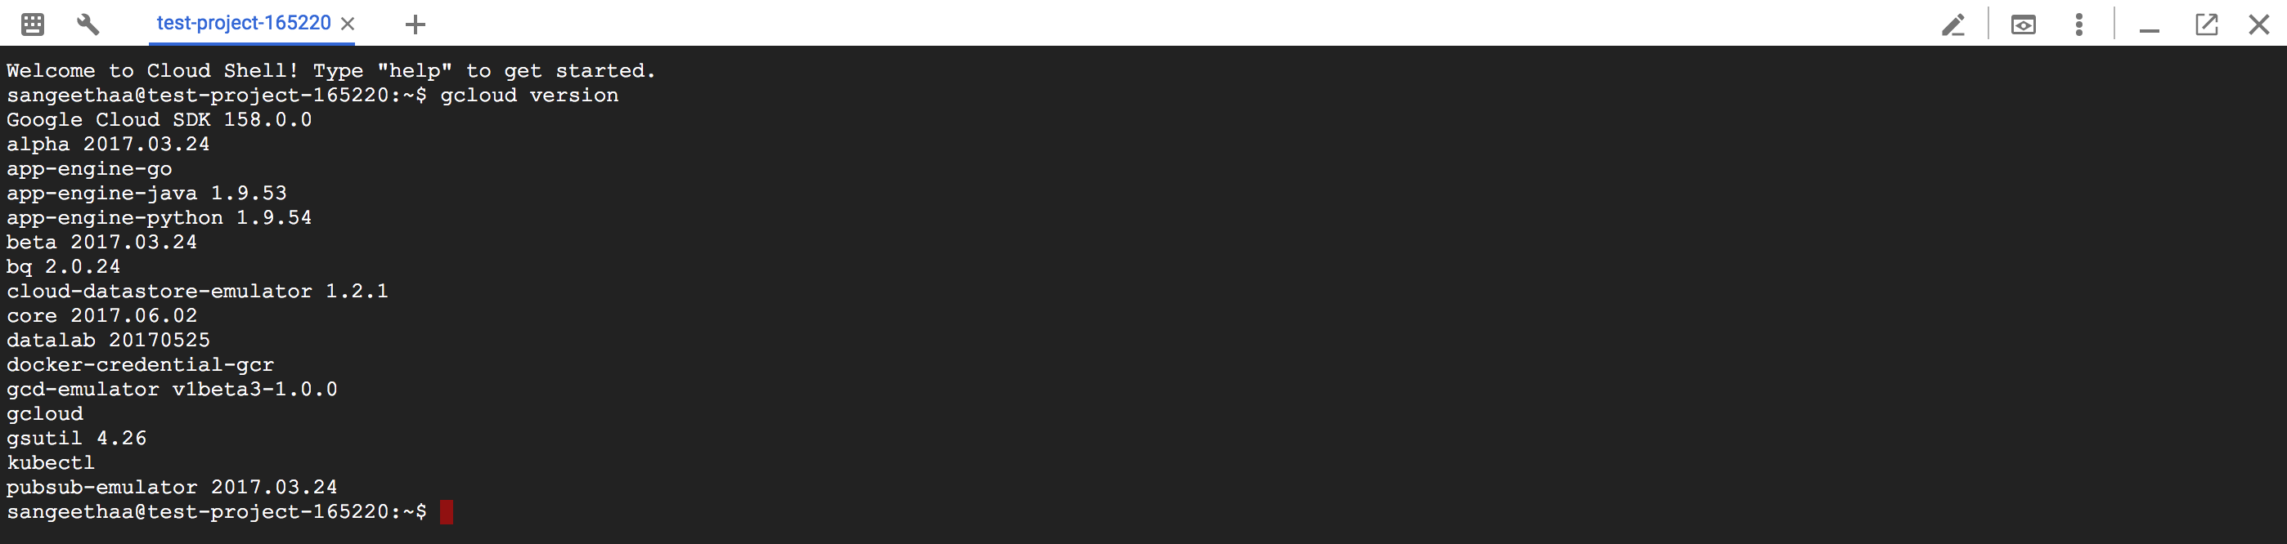

Slide 10


Slide 11


Slide 12
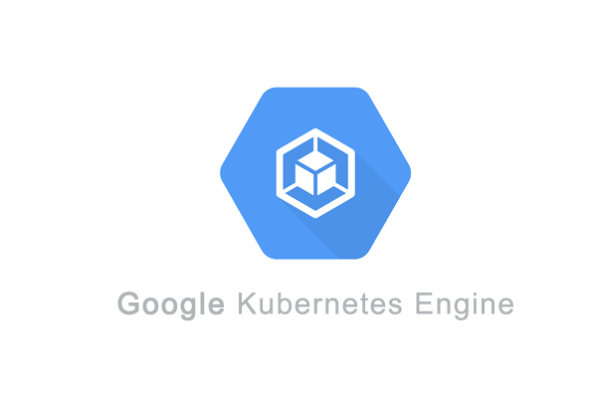

Slide 14


Slide 15


Slide 16
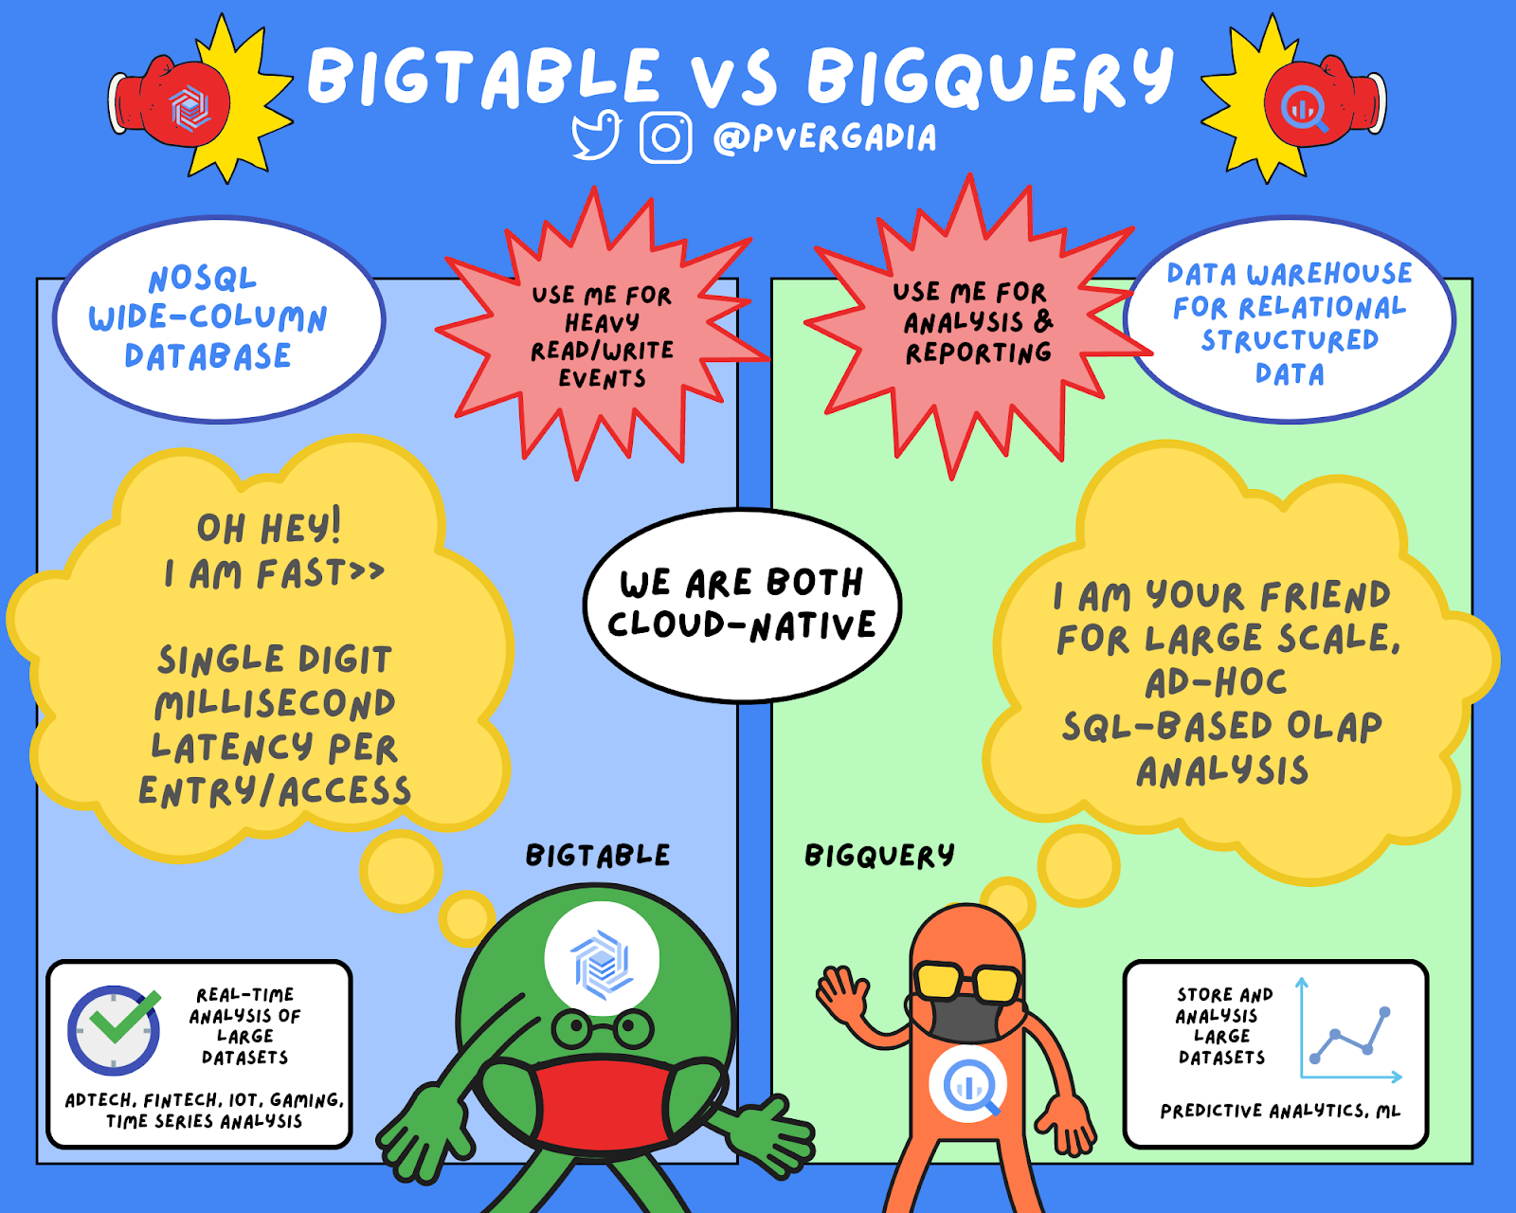

Slide 17
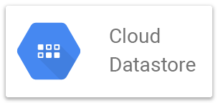

Slide 18
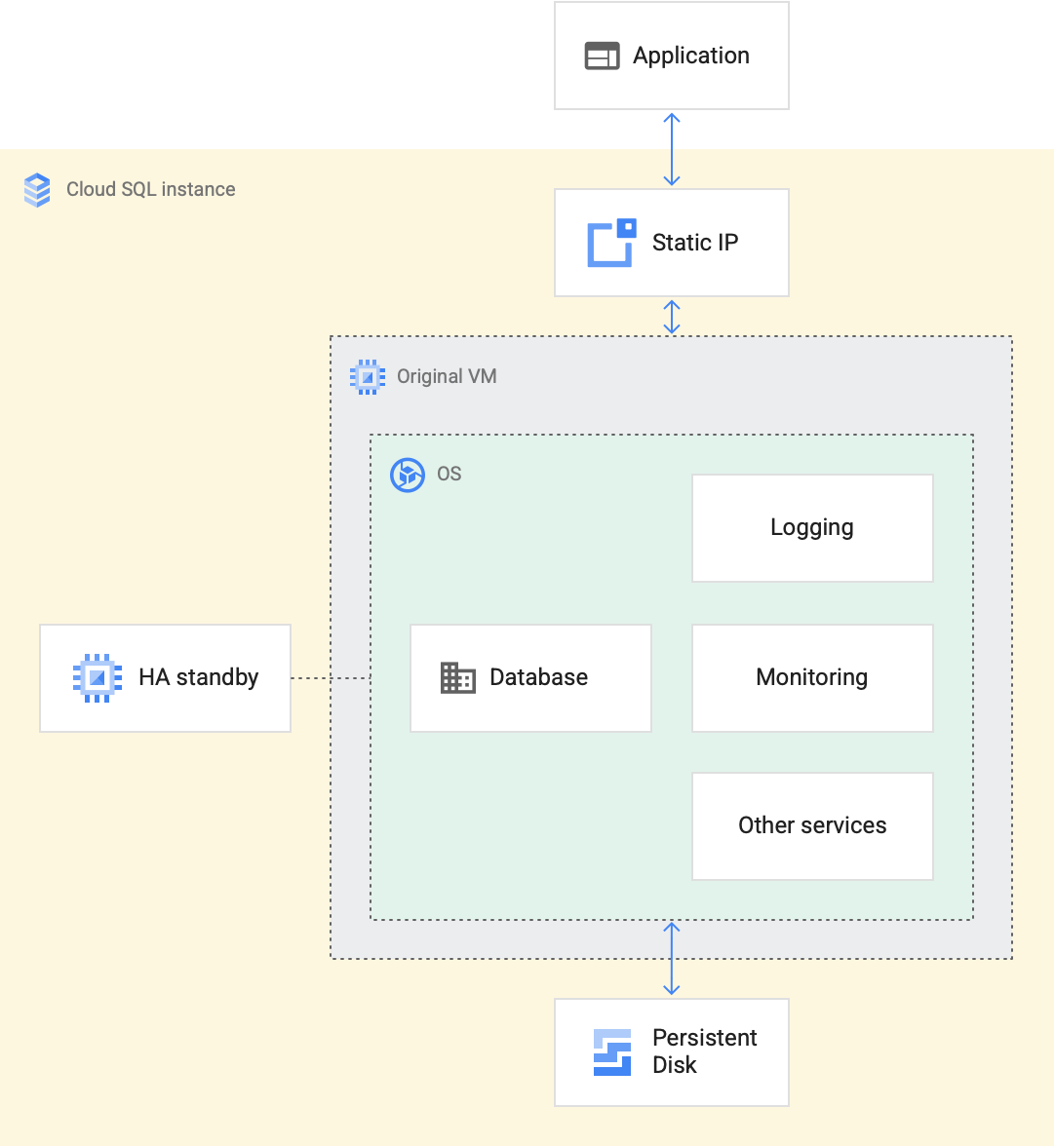

Slide 19
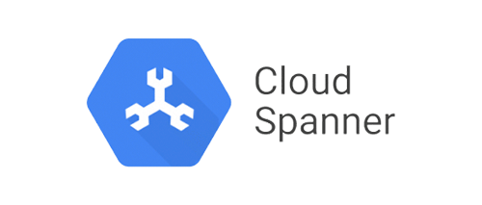

Slide 20
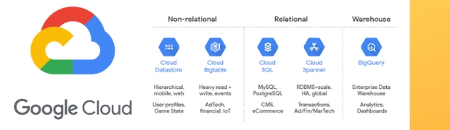

Slide 21
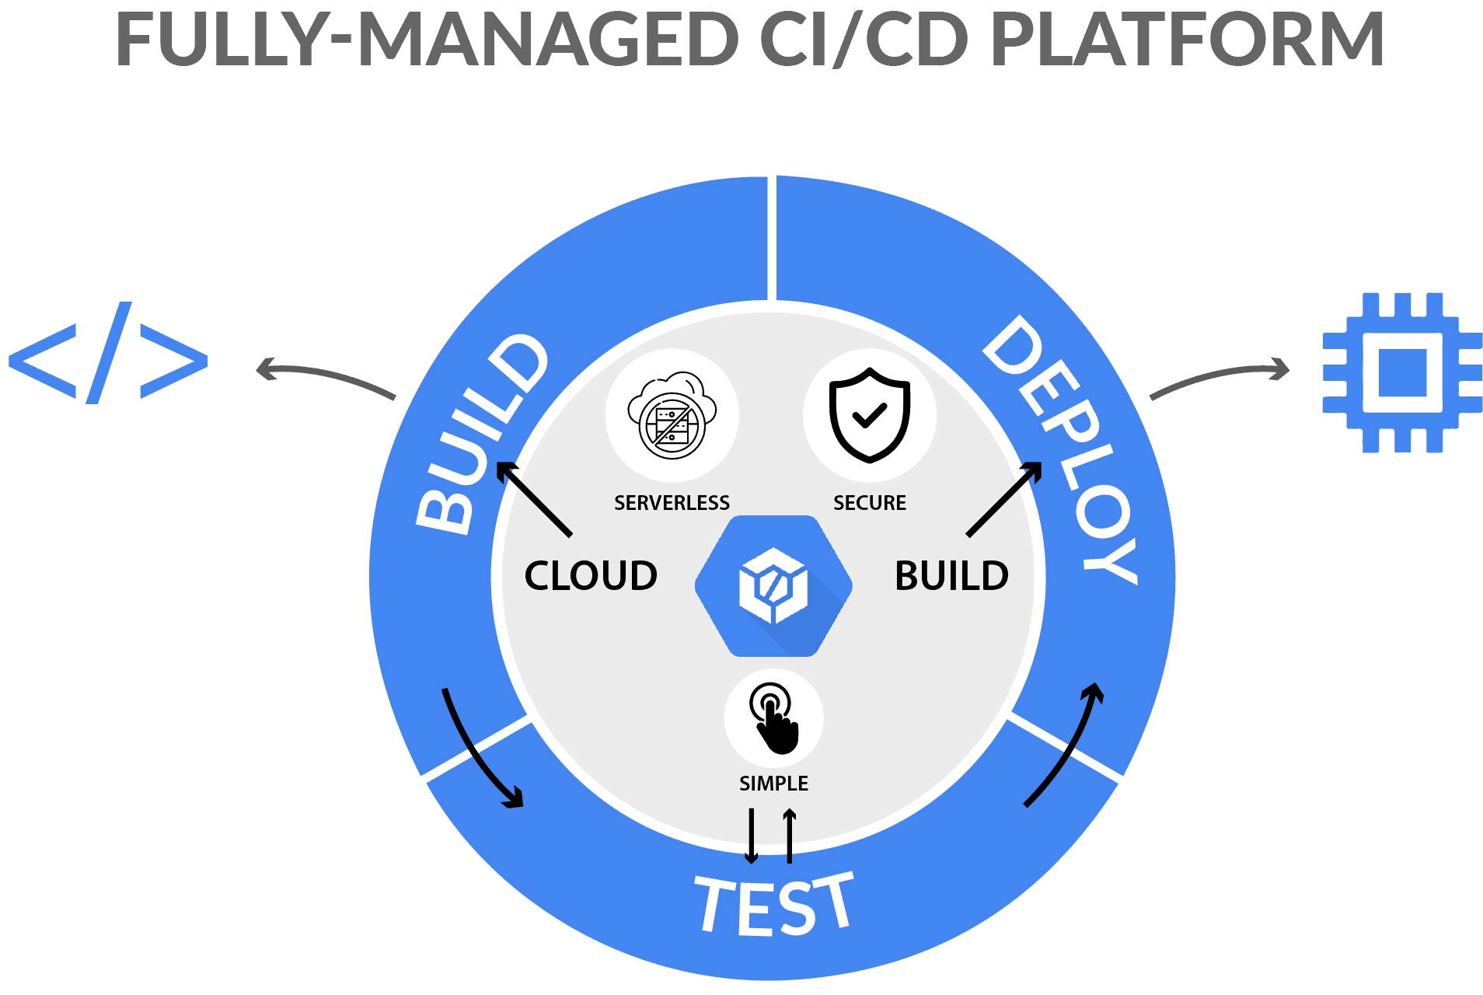

Slide 22
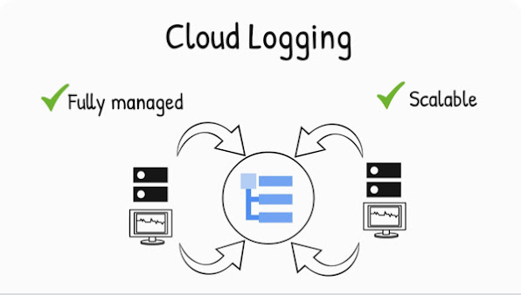

Slide 23


Slide 24
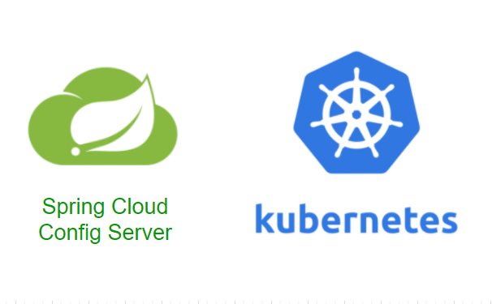

Slide 25
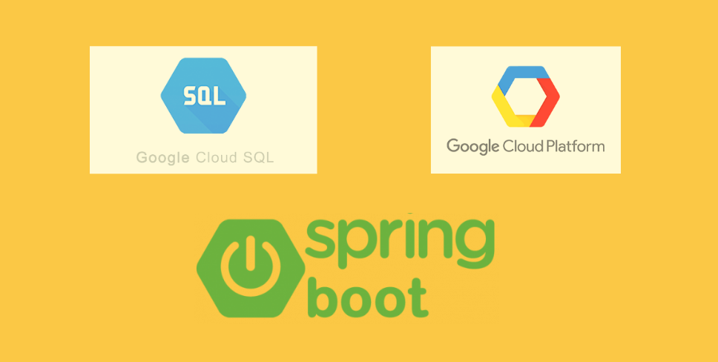

Slide 26
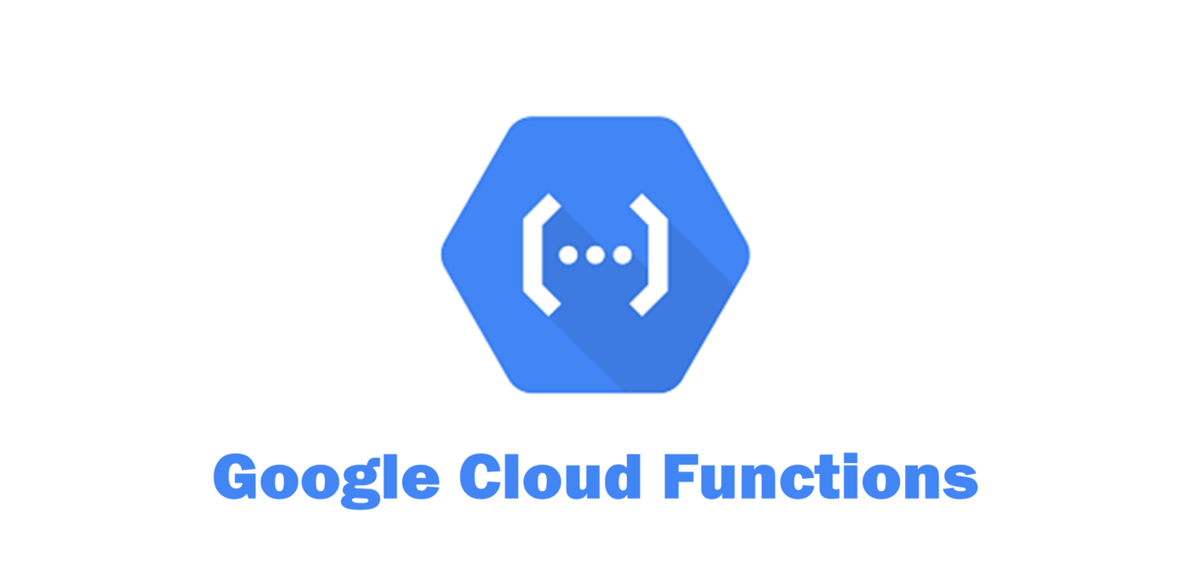

Slide 27
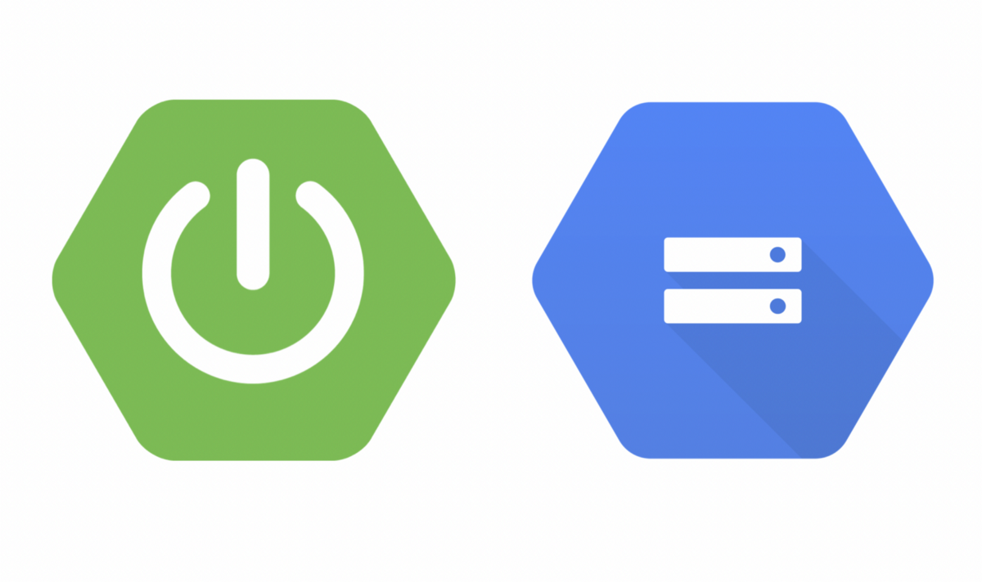

Slide 28


